Slide 1


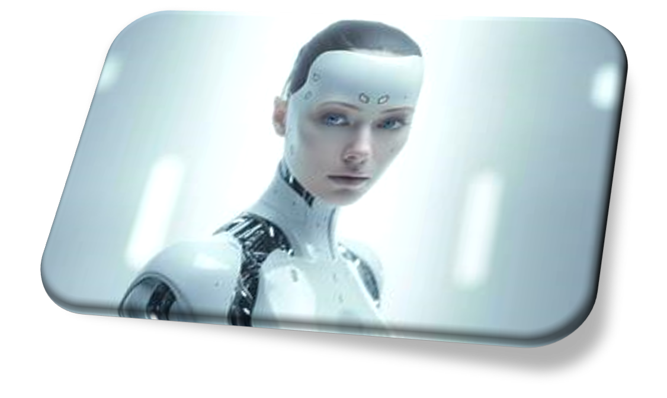
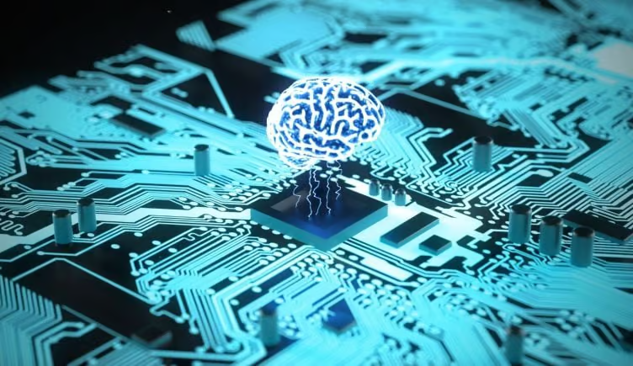
8 Days of NLP
Creating a Virtual Assistant

Slide 2

Day 1 Introduction to NLP – Project Kickoff
What is NLP?
Natural Language Processing (NLP) is a field of artificial intelligence (AI) that focuses on the interaction between computers and humans through natural language. The goal of NLP is to enable computers to understand, interpret, and generate human language in a way that is both meaningful and contextually relevant. NLP involves the application of computational techniques to process, analyze, and derive insights from human language data.
Notes:
Basic Concept of NLP

Slide 3








Day 1 Language Technology Apps
Notes:
Ask Students to discuss apps which use ai language models.

Slide 4

Day 1 Project Intro – Virtual Personal Assistant
There has to be a better way...
Notes:
Watch video of 24me which offers a virtual assistant.

Slide 5
Day 1 – Virtual Personal Assistant Key Functionalities
What are the key functions of an assistant?
What should a virtual assistant be able to do?

Slide 6
Day 1 – Virtual Personal Assistant Key Functionalities
Voice Recognition | Weather and Traffic Updates
Natural Language Comprehension | Smart Home Integration
Task Automation | Communication
Information Retrieval | Language Translation
Calendar Management | Personalised Recommendations
Location-Based Services | Note Taking
Entertainment | Health and Fitness Tracking
Continuous Learning

Slide 7
Day 1 – Project Setup
Essential Tools
Python Environment – Jupyter Notebook
NLTK
spaCy
Essential Learning
Tutorial One

Slide 8
Day 2 –
Text Processing &
VA Design
Essential Tools
Python Environment – Jupyter Notebook
NLTK
spaCy
Essential Learning
Tutorial One

Slide 9
Day 2 – NLP Algorithm
Segmentation
Break text into sentences
Tokenization
Split sentences into words
Stop Word removal
Remove unnecessary words
Stemming
Find root of word (May not be a word)
Lemmatization
Meaningful base form of a word (Will be a word)
Parts of Speech
Nouns, verbs, adjectives, etc
Named Entity Recognition
Recognize Proper names of people and places

Slide 10
Day 3 – UI Implementation
Link to Jupyter Notebook File: AuroVox.ipynb
Download the following file and open with Jupyter Notebook
AuraVox.ipynb
Integrate your NLP Code!
Essential Learning
Tutorial Two - TKinter

Slide 11
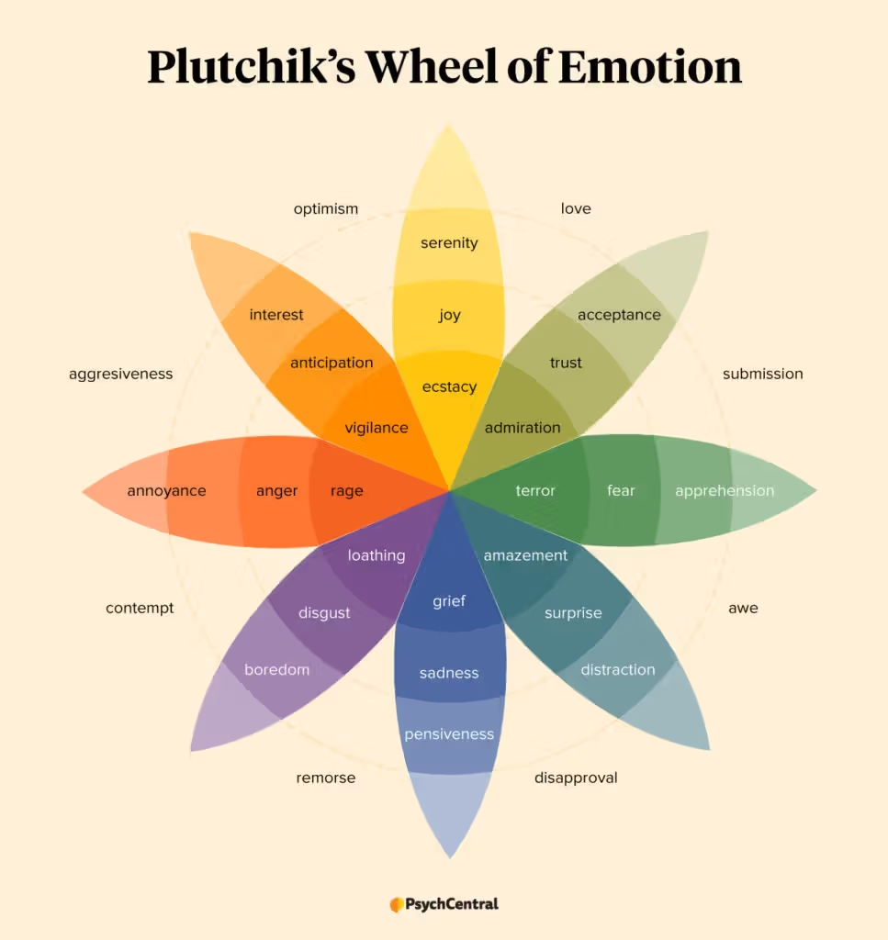
Day 4 – Sentiment Analysis
Essential Tools
Python Environment – Jupyter Notebook
NLTK
Essential Learning
Tutorial Four – Sentiment Analysis
Roberta
Task – Integrate Sentiment Analysis into your VA

Slide 12
Day 5 – Part-of-Speech Tagging and Refining Chatbot Interaction
Exa
Python Environment – Jupyter Notebook
NLTK
spaCy
Example
In the sentence "The cat is sitting on the mat," POS tagging would assign "The" as a determiner (DT), "cat" as a noun (NN), "is" as a verb (VBZ), "sitting" as a verb (VBG), "on" as a preposition (IN), and "the" as a determiner (DT), and so on.

Slide 13
Parts of Speech Identifiers
POS Tag | Meaning | Example
CC | Coordinating conjunction | and
CD | Cardinal number | 1, one
DT | Determiner | the, a, an
EX | Existential there | there
FW | Foreign word | café
IN | Preposition or subordinating conjunction | in, on, at
JJ | Adjective | big
JJR | Adjective, comparative | bigger
JJS | Adjective, superlative | biggest
LS | List item marker | 1, One, One.
MD | Modal | can, could
NN | Noun, singular or mass | cat, dog
NNS | Noun, plural | cats, dogs
NNP | Proper noun, singular | London
NNPS | Proper noun, plural | Smiths
PDT | Predeterminer | all, both, half
POS | Possessive ending | 's
PRP | Personal pronoun | I, you, he
PRP$ | Possessive pronoun | my, your, his
RB | Adverb | quickly
RBR | Adverb, comparative | faster
RBS | Adverb, superlative | fastest
RP | Particle | up, off, about
SYM | Symbol | $, %, &
TO | to | to
UH | Interjection | oh, ah, uh
VB | Verb, base form | eat
VBD | Verb, past tense | ate
VBG | Verb, gerund or present participle | eating
VBN | Verb, past participle | eaten
VBP | Verb, non-3rd person singular present | eat
VBZ | Verb, 3rd person singular present | eats
WDT | Wh-determiner | which, whatever
WP | Wh-pronoun | what, who, whom
WP$ | Possessive wh-pronoun | whose
WRB | Wh-adverb | where, when

